Slide 1
Context-Aware Search Personalization with Concept Preference
CIKM’11
Advisor：Jia Ling, Koh
Speaker：SHENG HONG, CHUNG

Slide 2
Outline
Introduction
Concept Extraction
Search Context Discovery
Temporal Cutoff
Query relevance
SERPs Similarity
Concept Preference Derivation
Clickthrough
Query Reformulation
Personalized Ranking Function
Experiment
Conclusion

Slide 3
Introduction
Search engines have become an indispensable tool of people's daily activities
search queries are typically short and ambiguous
limited clues to infer a user's true search intents
A framework that utilizes search context to personalize search results

Slide 4
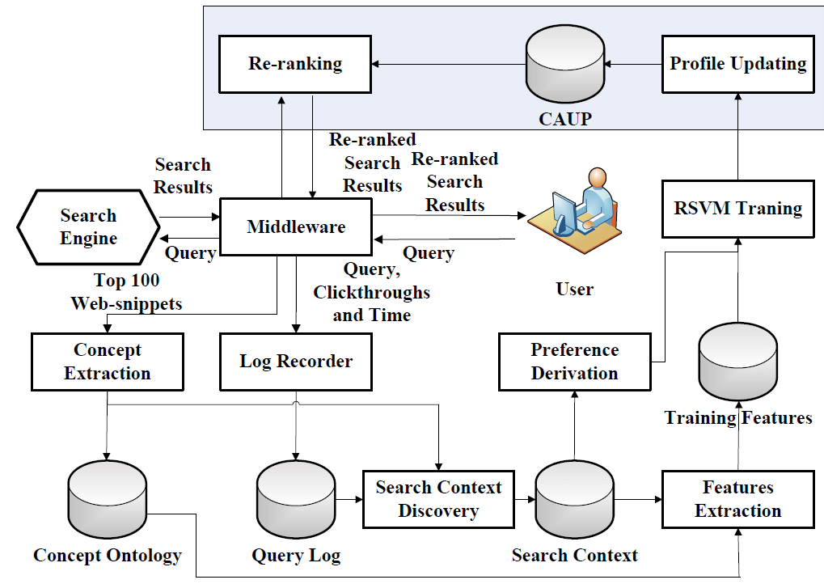

Slide 5
Concept Extraction
A term/phrase c appears frequently in the web-snippets arising from a query q, then c represents an important concept related to q
Extracts all the terms and phrases from the web-snippets arising from q and denote a term or a phrase as c_{i}
A “web-snippet” denotes the title, summary and URL of a Web page returned by search engines.

Slide 6
Concept Extraction
Search engine
N snippets
Example:
Query = “cloud computing”
1000 snippets
C₁ = “service”
C₂ = “community cloud”
7 snippets contains C₁
5 snippets contains C₂
Support(C₁) = 7/1000 * 1 = 0.049
Ɵ = 0.03
Support(C₂) = 5/1000 * 2 = 0.07

Slide 8
Search Context Discovery
Temporal Cutoff
Query relevance
SERPs Similarity

Slide 9
Temporal Cutoff
Temporal cutoffs ranging from 5 minutes to 30 minutes are frequently used to identify session boundaries.
30 minutes cutoffs achieves fairly good performance

Slide 10
Query relevance
Utilize query reformulation taxonomy to evaluate the relevance between queries
Detect a certain type of change between two queries.

Slide 11
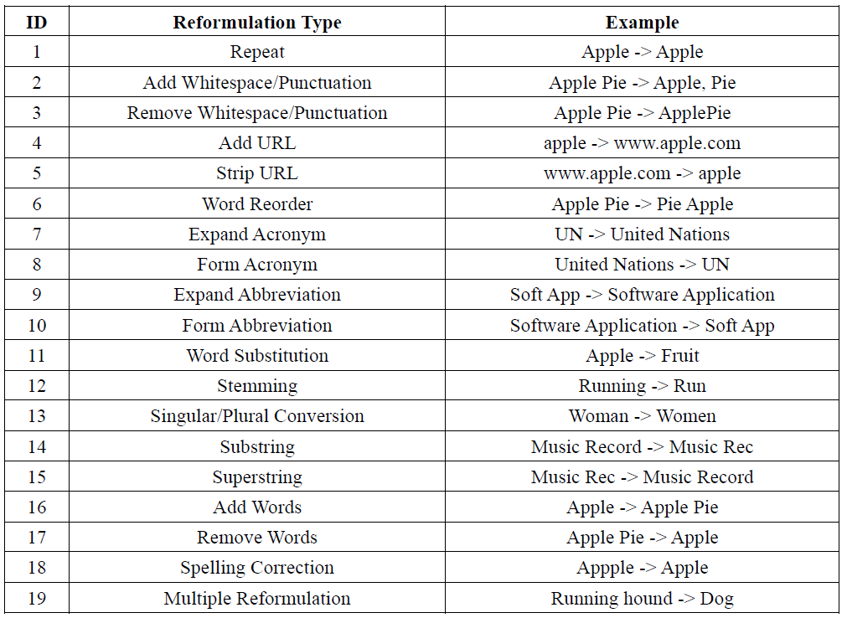
Query relevance

Slide 12
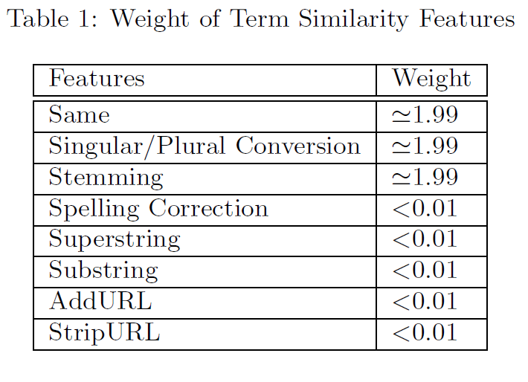
horses race -> horse
Query reformulation : RemoveWords, SingularAndPlural
Single reformulation, damage the query integrity
Multiple reformulation,
reformulate queries by combining more than one reformulation types
Enumerating each combination of reformulation types is infeasible
Train SVM model

Slide 13
SERPs Similarity
The limitation of taxonomy-based method is that it can’t capture reformulations beyond the predefined taxonomy
For each query q, we extract concepts from the top 100 snippets returned by the search engine and then the query is represented as a concept vector C_{q}

Slide 14
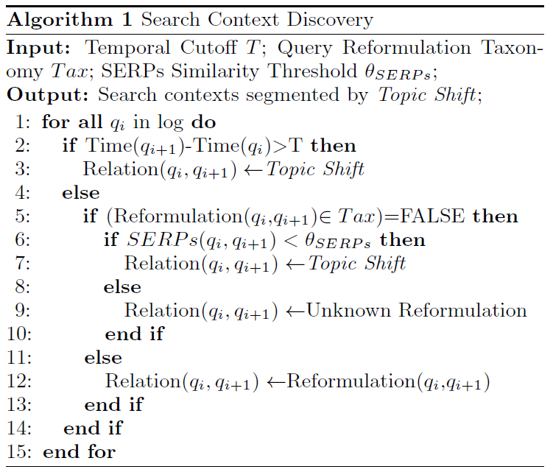
Search Context Discovery

Slide 15
Concept Preference Derivation
Clickthrough
Users scan the results in order from top to bottom.
Users at least read the top two result snippets and the first one is much more likely to be clicked on.
Users read one snippet below any they click on.
User's examination range of the search results
If a snippet ranked i is the last snippet that a user clicked on the result, the examination range of the result is 1 -> (i + 1).
If no snippet is clicked on the result, the examination range of the result is 1 -> 2.

Slide 16
Concept Preference Derivation
Assume (s₁,s₂…) is the ranking of snippets arising from query q, the corresponding concept set for each snippet is denoted as (C₁,C₂…).
Click >_{q} Skip Above:
If s_{i} is clicked while s_{j} is not clicked and i > j, derive a concept preference judgement c_{a} >_{q} c_{b} for concept c_{a} from C_{i} and concept c_{b} from C_{j} .
Click >_{q} No-Click Next:
If s_{i} is clicked while s_{j} is not clicked and j = i + 1, derive a concept preference judgment c_{a} >_{q} c_{b} for concept c_{a} from C_{i} and concept c_{b} from C_{j} .
Click >_{q’} No-Click Earlier:
Assume q’ is an earlier query of q within the search context. (s’₁,s’₂…) is the ranking of snippets arising from q’ and the corresponding concept set for each snippet are denoted as (C’₁,C’₂…). If s_{i} is clicked while s’_{j} is skipped by the user, derive a concept preference judgment c_{a} >_{q’} c’_{b} for concept c_{a} from C_{i} and concept c’_{b} from C’_{j} .

Slide 17
Snippet₁(Concept set C₁)
Snippet₂(Concept set C₂)
Snippet₃(Concept set C₃)
Snippet₄(Concept set C₄)
Search engine
query q
Click >_{q} Skip Above: if user clicked Snippet₃, preference judgment C₃ > C₂, C₃ > C₁
Click >_{q} No-Click Next: if user clicked Snippet₃, preference judgment C₃ > C₄
Snippet₁(Concept set C₁)
Snippet₂(Concept set C₂)
Snippet₃(Concept set C₃)
Search engine
query’ q’
earlier query
Click >_{q’} No-Click Earlier: For q, user clicked Snippet₃
For q’, user clicked Snippet₂
preference judgment C₃ >_{q’} C₁

Slide 18
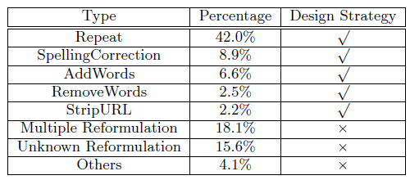
Concept Preference Derivation
Query reformulation
Reflect the semantic relation between two consecutive queries
Evaluate the distribution of query reformulation types from a 10K search query log
manually label the reformulation type between queries

Slide 19
Concept Preference Derivation
Better understand the nature of the five query reformulation types
Conduct an empirical study on the user's Click/Skip behavior before and after query reformulation.
A query is labeled as Click(C) if it results in clickthrough, otherwise, it is labeled as Skip(S).
the C-C pattern is further categorized as C-C(S/D) if the clicked URL is the same/different for the two queries.

Slide 20
Repeat Strategy:
Assume q’ is an earlier query of q within the search context and q is the repeated query of q’. (s’₁,s’₂…) is the ranking of snippets arising from q’ and (s₁,s₂…) is the ranking of snippets arising from q. The combined snippet ranking is denoted as (s_{c}¹,s_{c}²…) and s_{c}^{i} is labeled as clicked if s_{i} or s’_{i} is clicked.
Derive preference using Click >_{q} Skip Above and Click >_{q} No-Click Next from the combined ranking list instead of original ones.
q’
q
q
S’₁
S’₂
S’₃
S₁
S₂
S₃
S¹
S²
S³_{c}
S-C,C-C(D) : conflicting preference
C-C(S) : preference judgment

Slide 21
SpellingCorrection Strategy:
Assume q’ is an earlier query of q within a search context. If q results in clickthrough while q’ results in no clickthrough, only derive preference judgment for q by Click >_{q} Skip Above and Click >_{q} No Click Next
q’
q
S’₁
S’₂
S’₃
S₁
S₂
S₃
S-C : preference judgment
No
click

Slide 22
AddWords Strategy:
Assume q’ is an earlier query of q within a search context. Terms belong to q/q’ are denoted by the set S. If q results in clickthrough, concepts containing terms in S is preferred over those skipped concepts for query q.
q’ = “apple”
q = “apple juice”
S = {juice}
If concepts containing “juice”,
these concepts are preferred to concepts in skipped snippets.
S-C,C-C(D): large proportion, closer to user ‘s information need

Slide 23
RemoveWords Strategy:
Assume q’ is an earlier query of q within a search context. Terms belong to q’/q are denoted by the set S. If q results in clickthrough, clicked concepts is preferred over those containing terms in S for query q.
q’ = “apple computer power”
q = “apple computer”
S = {power}
For q, clicked concepts are preferred to those concepts containing “power”.
S-C,C-C(D): large proportion, get general information

Slide 24
StripURL Strategy:
Assume q’ is an earlier query of q within a search context. If q is obtained by stripping URL from q’, snippets whose URLs sharing terms with q are preferred by the user
Navigational search
Capture the use’s preference with respect to URLs rather than concepts
Promote results whose URLs share terms with the reformulated query

Slide 25
Personalized Ranking Function
Suppose we have input preference judgment over concepts c_{i} and c_{j} for a given query q in the following form: c_{i} >_{q} c_{j}. We write the above preference as a constraint as follows:
We first build a concept space, which contains concepts in the preference judgment as well concepts have semantic relation with them in the concept ontology.
Then, for each c_{i} arising from q, we create a feature vector (q; ci) =(f₁,f₂,…f_{n}) based on all concepts in the concept space.

Slide 26
personalized
q : C₁>C₂, C₁>C₃
q : {C₁,C₂,C₃,C₄,C₅,C₆,C₇}
Training w (C₁ and C₄ are important)
C₄>C₅
 | c₁ | c₂ | c₃ | c₄ | c₅ | c₆ | c₇
(q,c₁) | 1 | Sim(c₁,c₂) | Sim(c₁,c₃) | Sim(c₁,c₄) | Sim(c₁,c₅) | Sim(c₁,c₆) | Sim(c₁,c₇)
(q,c₂) | Sim(c₂,c₁) | 1 | Sim(c₂,c₃) | Sim(c₂,c₄) | Sim(c₂,c₅) | Sim(c₂,c₆) | Sim(c₂,c₇)
(q,c₃) | . | . | . | . | . | . | .
(q,c₄) | . | . | . | . | . | . | .
(q,c₅) | . | . | . | . | . | . | .
(q,c₆) | . | . | . | . | . | . | .
(q,c₇)
R(s₁,s₂,…s_{n})
S₁ = {c₂,c₃}
P(S₁) = w₂ * (q,c₂) + w₃ * (q,c₃)

Slide 27
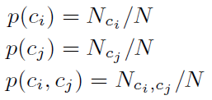
Personalized Ranking Function
The semantic relation between two concepts, sim(c_{i},c_{k}) is measured by Pointwise Mutual Information (PMI)

Slide 28
Personalized Ranking Function
Original ranking of search results arising from q is denoted by R(s₁,s₂,…s_{n}), where snippet notes the snippet ranked at position i.
C_{i} be the set of concepts extracted from snippet s_{i}

Slide 29
Experiment
Experiment setup
Compare the performance of search context algorithm
Evaluate strategies
Clickthrough-based
Queryreformulation-based
Combined

Slide 30
Experiment setup
Experimental data
AOL search query log
Each record contains:
User ID
Query
Timestamp
URL that user clicked

Slide 31
Compare the performance of search context algorithm
The users were asked to perform relevance judgment on the top 100 results for each query by filling in a score for each search result to reflect the relevance of the search result to the query.
Define three level of relevancy
Good : relevant
Fair : Unlabeled
Poor : irrelevant
Documents rated as “Good” are used to compute the Top-N precisions for different methods.

Slide 32
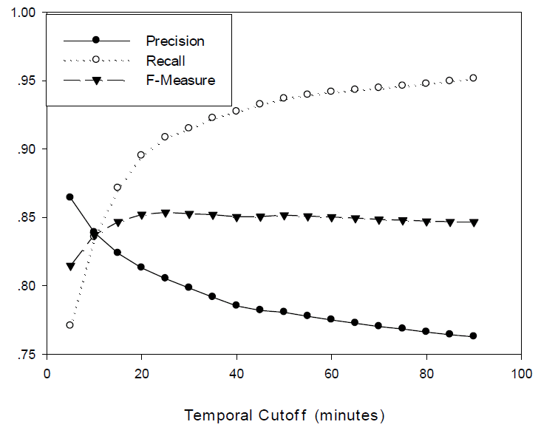
Compare the performance of search context algorithm
25~30 mins, the highest F-measure
Default temporal cutoff 30min

Slide 33
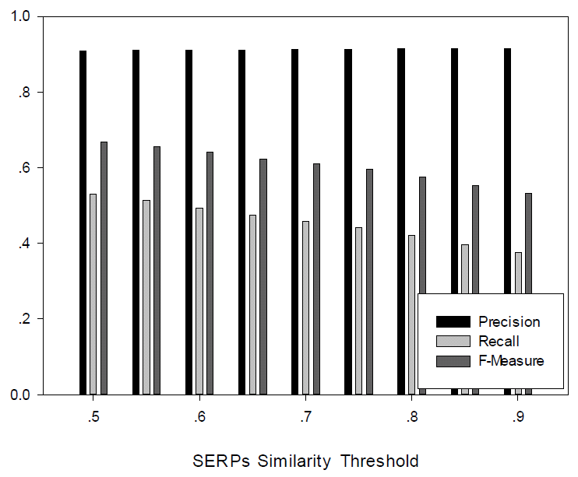
Compare the performance of search context algorithm
default value = 0.75

Slide 34
Temporal Cutoff : low precision, high recall. Put relevant and irrelevant queries together
Single Reformulation : high precision, low recall. Based on query reformulation, but too strict
New Reformulation : good precision, good recall. Multiple reformulation
SERPs : high precision, low recall.
SERPs and New Reformulation : boost the low recall

Slide 35
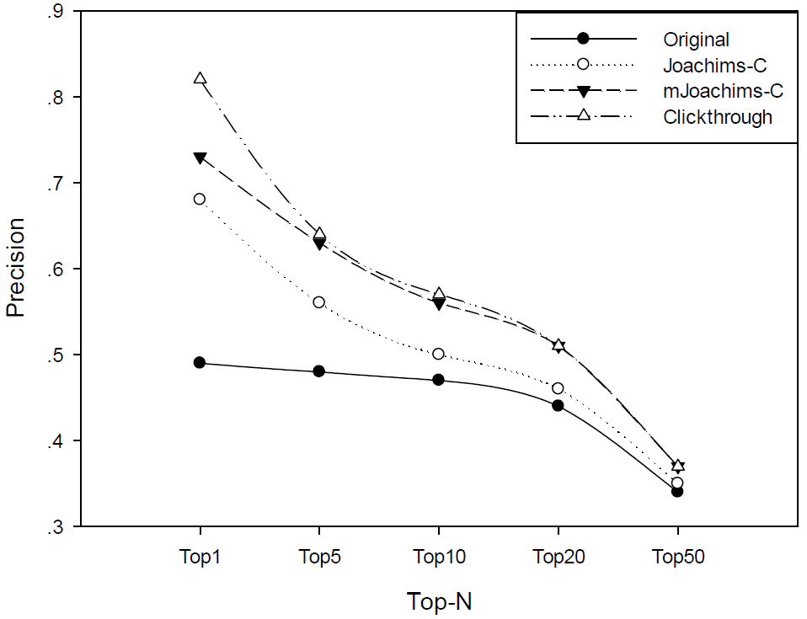
Personalization with Clickthrough strategies
Joachims-C -> Click >_{q} Skip Above
mJoachims-C -> Click >_{q} Skip Above + Click >_{q} No-Click Next
Clickthrough -> Click >_{q} Skip Above + Click >_{q} No-Click Next + Click >_{q’} No-Click Earlier

Slide 36
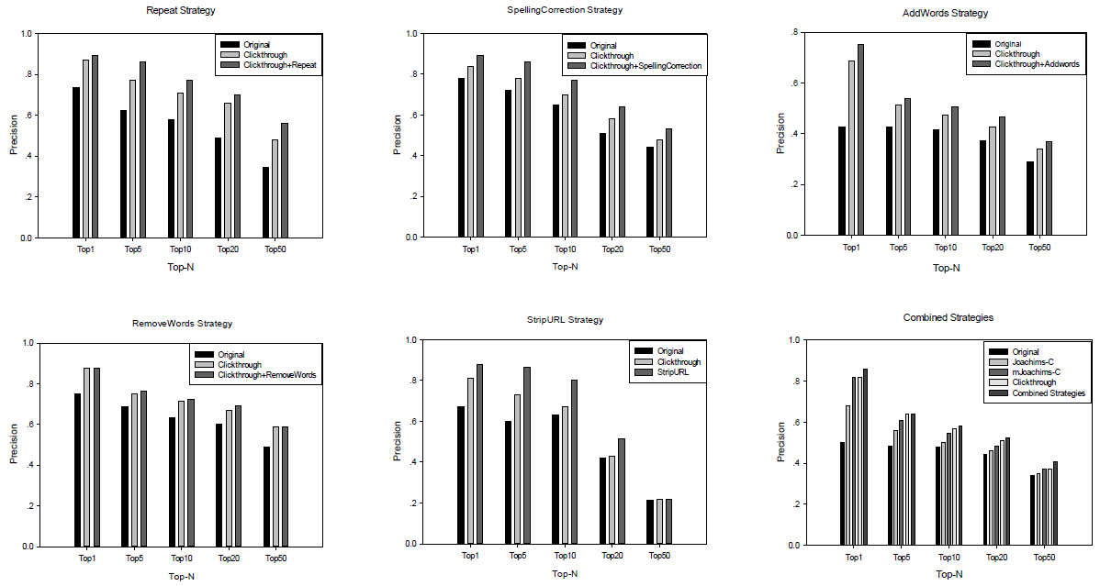
Personalization with Reformulation strategies

Slide 37
Conclusion
Using search contexts to facilitate concept-based search personalization.
Introduce a new method that discovers search contexts from raw search query log
This method captures comprehensive information through one-pass of the query log and has good performance in keeping context coherency and integrity.
The proposed strategies is able to capture the user's preference with higher accuracy than existing approaches

